Slide 1
The Team Charter Word Doc
A Team Charter outlines your team's overall objectives, resources, and constraints.
A living, breathing, dynamic and reflective document that should be reviewed and updated.
Lodge the charter into your Canvas group home page.
Items focused on in the charter:
a team SWOT analysis,
team milestones,
team minutes template,
agreed team behaviours; and
a team sign-off
Note: A penalty of 3 marks applies for a non-submitted charter

Slide 2
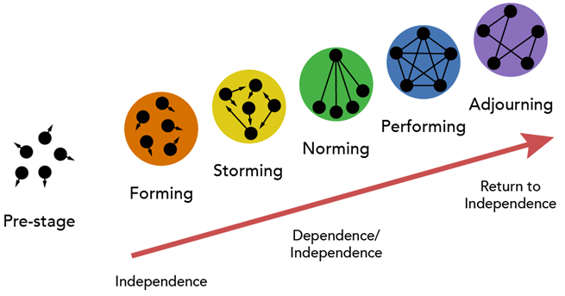
Team Development Stages
Tuckman’s stages of team development (1965)

Slide 3
Professional Capabilities
A series of Professional Capabilities are unpacked inside the charter.
Key Professional Skill 1: Collaborative Communication (Forming stage)
Key Professional Skill 2: Problem-Solving and Decision Making (Storming stage)
Key Professional Skill 3: Power and Influence in Groups (Norming stage)
Key Professional Skill 4: Cooperation, Consensus Decision-making and Effective Communication in Groups (Performing stage)
Key Professional Skill 5 – How to Run a More Effective Meeting
Key Professional Skill 6 – Sort your tasks by urgency and importance
Key Professional Skill 7 – Managing Team Free-loaders

Slide 4




Reach out using any means if you need clarity on the Team Charter and how it relates to the Investigative Case Study Assignment.

